Slide 2

The House That I Live In

Slide 3

This Fleshly Tabernacle
God Gave It To Me – Psalm 139:14 “ I am fearfully and wonderfully made”
Ability to KNOW!
I am SPIRIT, BODY and SOUL - 1 Thessalonians 5:23
God communicates with my INTELLECT through His Word- Romans 1:16 “ the power of God to salvation for everyone who BELIEVES”

Slide 4
This Fleshly Tabernacle
BELIEF is a function of the INTELLECT!
It is God's desire to be glorified by "a people." 1 Peter 2:9,10
A people who would YIELD TO HIM – Romans 6:11-13
1 Corinthians 9:27 “But I discipline my body and bring it into subjection, lest, when I have preached to others, I myself should become disqualified.”
Job 14:14 “If a man dies, shall he live again?”
SOUL or SPIRIT will never die – body must die- Hebrews 9:27

Slide 5

The Church, House of God
This I dwell in by CHOICE!
Hebrews 8:2 “..true tabernacle (house), which the Lord pitched..." is the church
Therein I Am Privileged to Worship and Serve God!
1 Timothy 3:15 “know how you ought to conduct yourself in the house of God, which is the church of the living God, the pillar and ground of the truth.”
Assurance of being IN that HOUSE or CHURCH – Acts 2:41,47

Slide 6
The Church, House of God
God is the “Father” in this house – Matthew 6:9
Those baptized into Christ are “children” – Galatians 3:26,27
I Have Been Added! – Act 2:41,47
1 Corinthians 15:19 “If in this life only we have hope in Christ, we are of all men the most pitiable.”
Thanks be to God, and my Lord and Savior, Jesus Christ - I can look BEYOND THIS LIFE!

Slide 7

The One In The Presence of God
One Day I’m Going To Move!
2 Corinthians 5:1 “if our earthly house, this tent, is destroyed, we have a building from God, a house not made with hands, eternal in the heavens.”
John 14:1,2 “In My Father’s house are many mansions”
In this eternal house I will live FOREVER – Hebrews 11:10 “...the city which has foundations, whose builder and maker is God.”

Slide 8
As Much As I Can Possibly Desire-
And More Than I Deserve!
THIS is really the House I Want To Live In!
And the House From Which I Will Never Have To Depart!
Praise God for this possibility and promise!
How tragic to leave God out of the fleshly house, and be turned away from His eternal house!

Slide 9
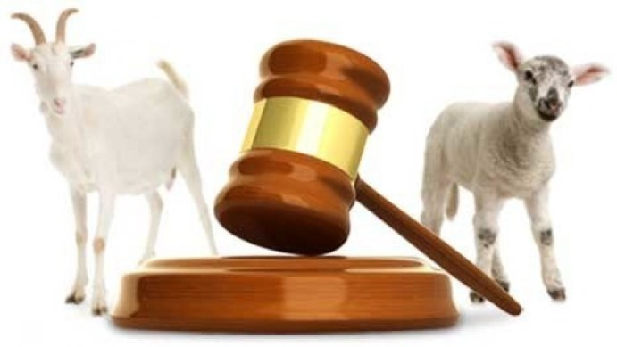
Judgment Scene
Matthew 25:46 “And these {i.e. unrighteous} will go away into everlasting punishment, but the righteous into eternal life.”
ALL of US will be ONE OR THE OTHER!
Psalm 23:6 “Surely goodness and mercy shall follow me All the days of my life; And I will dwell in the house of the Lord Forever.”

Slide 10
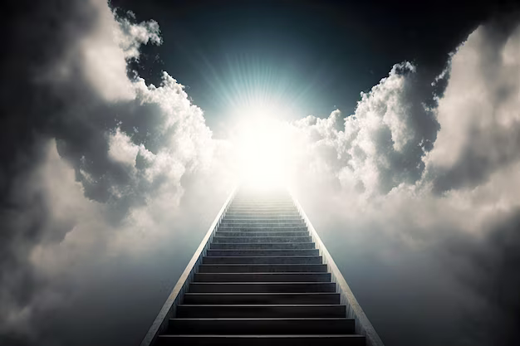
Two Other Considerations
Abraham – Hebrews 11:9,10 “he waited for the city which has foundations, whose builder and maker is God.”
Entering by the Gospel into the HOUSE OF GOD is the only assurance of entering into THE HOUSE OF GOD FOR ETERNITY!
1 Corinthians 15:24,58

Slide 11
Won’t You Enter Into God’s Arrangement For Salvation?
To Do So is to make the FIRST STEP toward that ETERNAL HOUSE OF GOD!
What could be more important to YOU TODAY, than taking this important step?

